Slide 1

Medical Insurance Cost Estimator
Georgia Tech Bootcamp Project 4

Slide 2
THE TEAM
Karina Hutula
Ling Lu
Kyle Shimberg
Ranjani Anjur Venkatraman
Dawn Washington

Slide 3
Agenda
Introduction
Industry Outlook
Technologies/Data Source
Project Overview
Website
Insights/Next Steps
Q & A

Slide 4

OUR BIG IDEA
Our mission is to provide a nationally recognized site used by companies to predict medical costs for potential employees.

Slide 5






Industry outlook
54%
$7,470
83%
$10,966
5.3%
Average US Population with Employment-based Health Insurance
Average Paid by Employers per Employee Annually
Average percentage of healthcare premium paid by Employers
Average cost of healthcare per person in the US
Expected Growth Per Year
Success

Slide 6










Project overview
Data Source : Medical Cost Personal Dataset from Kaggle
(https://www.kaggle.com/mirichoi0218/insurance)
Exploratory Data Analysis - Pandas / Jupyter Notebook
Visualizations – Matplotlib and Tableau
Regression Modeling
Development of the Website
Deployment of the Website

Slide 7

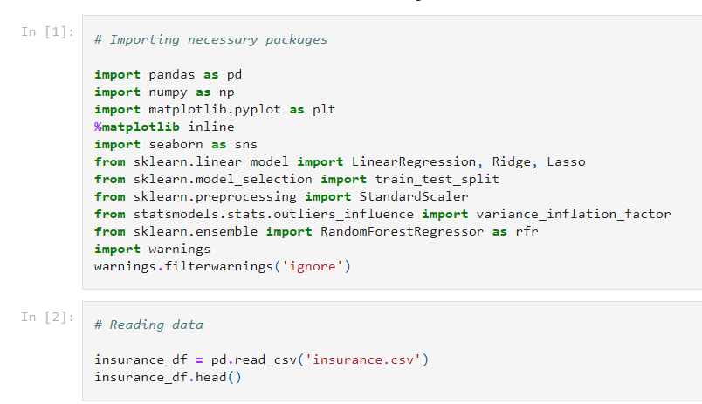
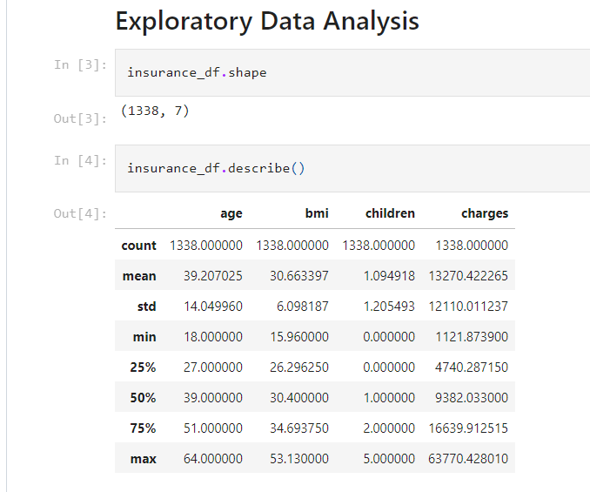
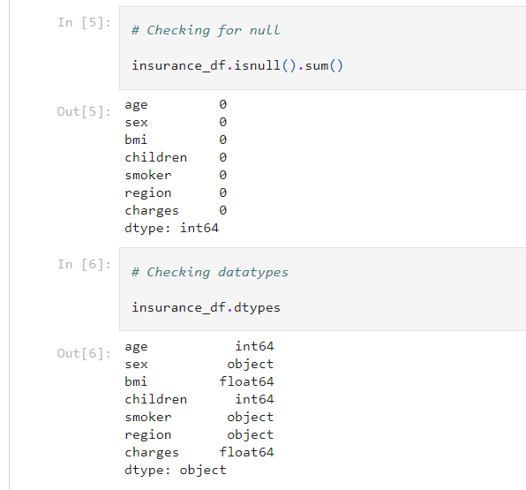
exploratory data analysis

Slide 8
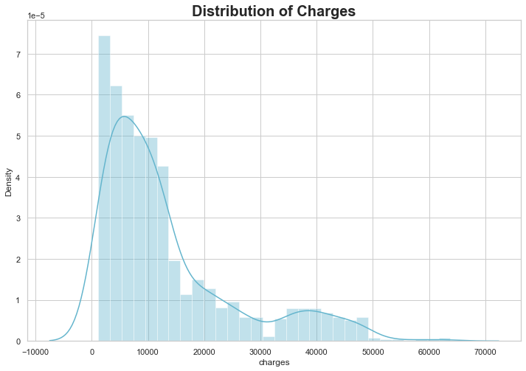

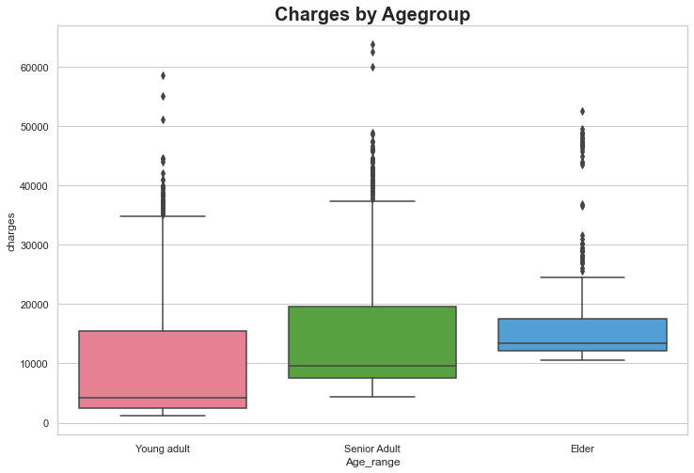
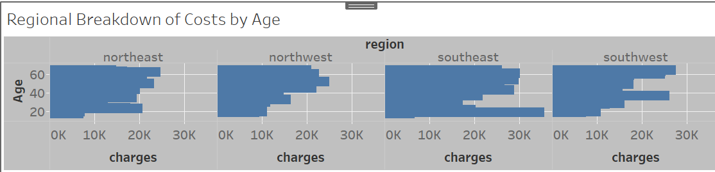
Visualizations

Slide 9
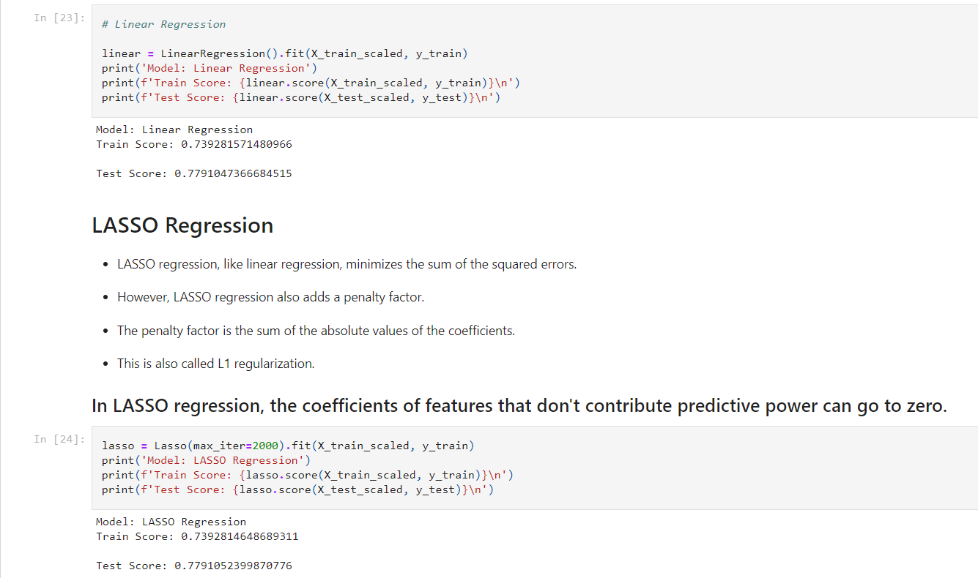
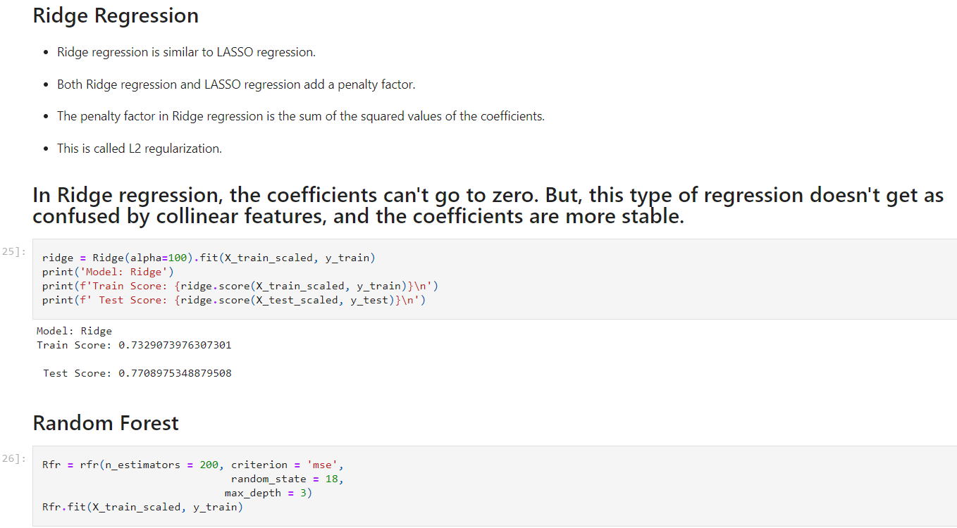
Linear regression Lasso Regression Ridge Regression Random Forest
Regression Modeling

Slide 10

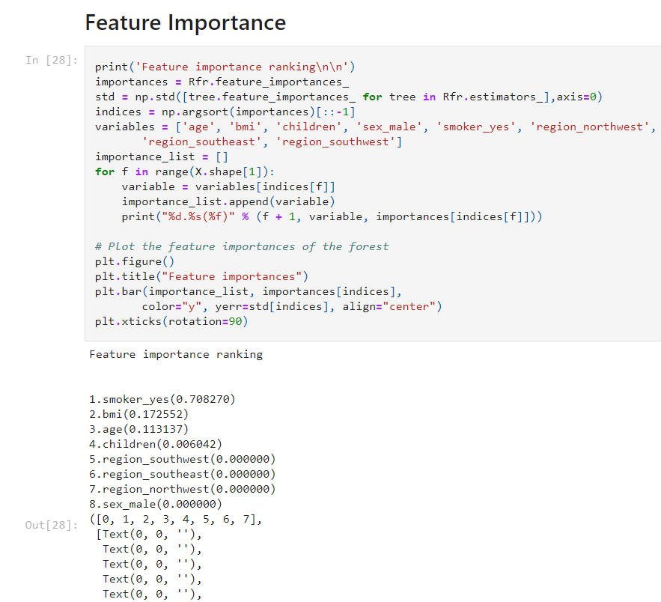
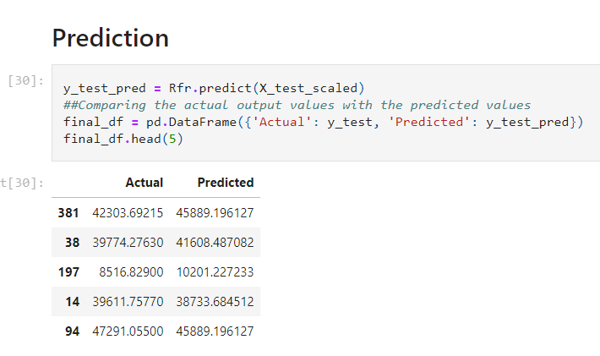
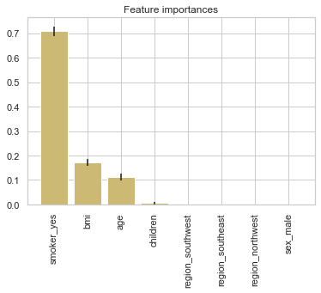
Feature Importance / Prediction

Slide 11
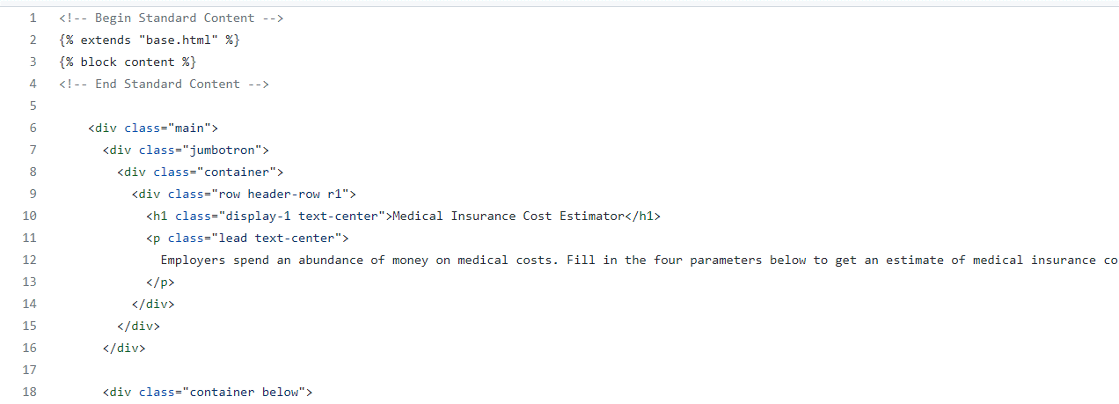
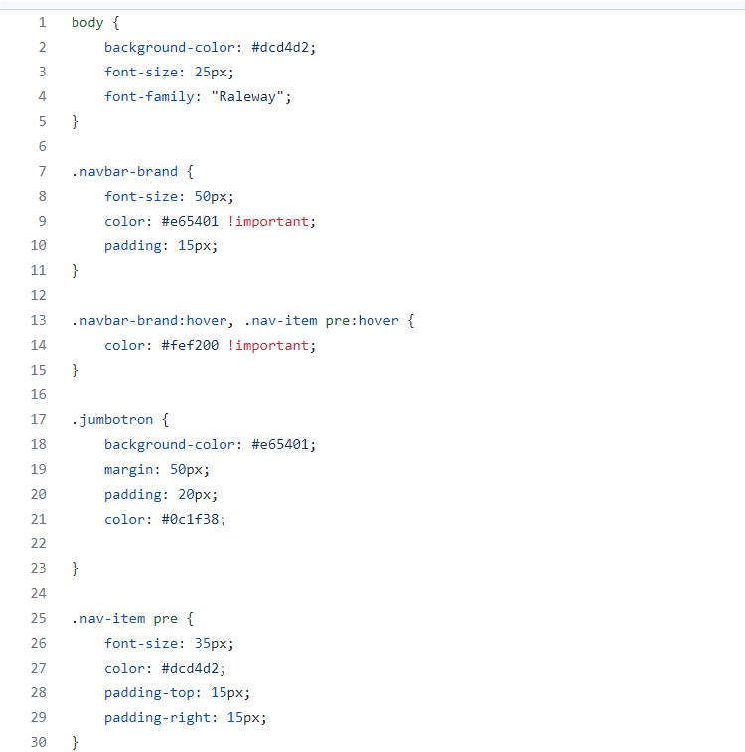
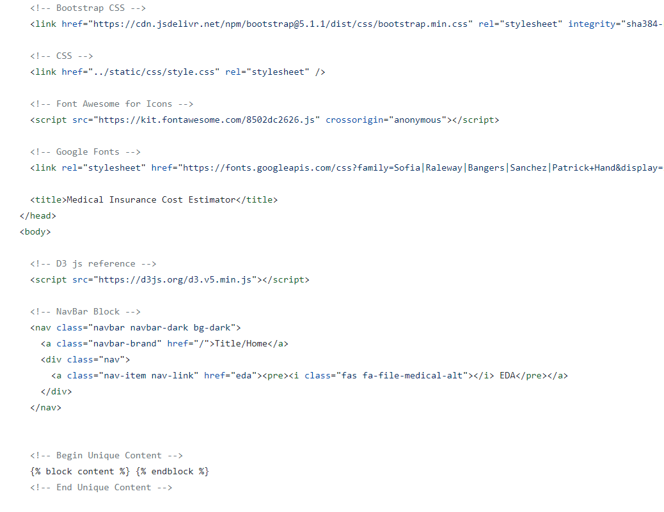
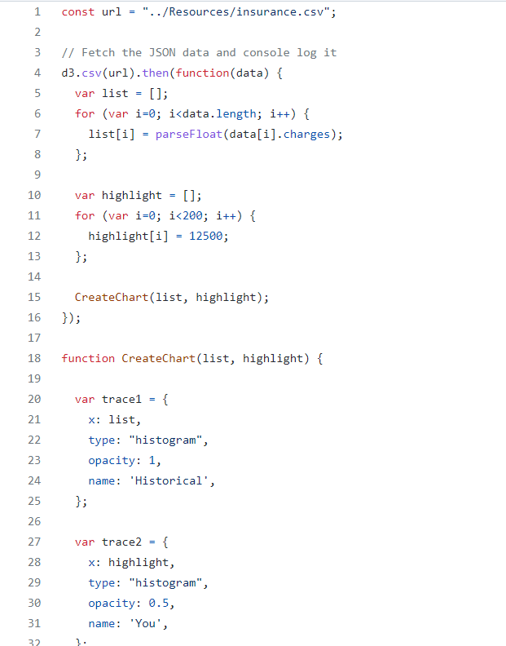
development of the website

Slide 12
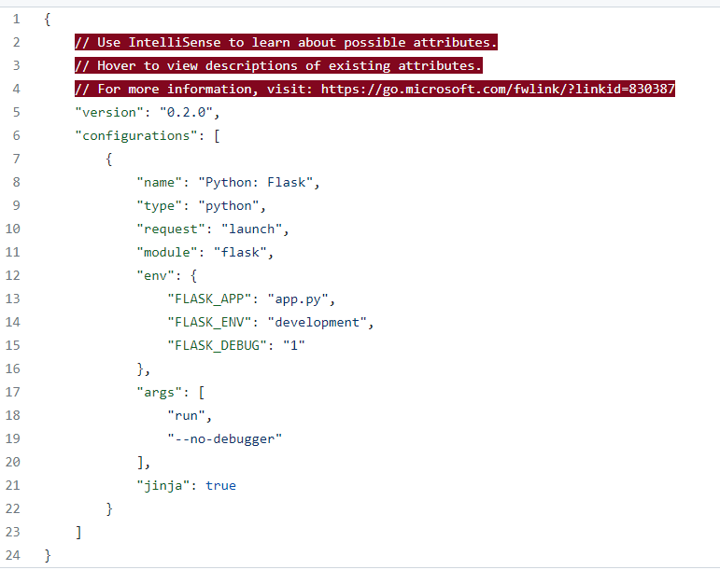
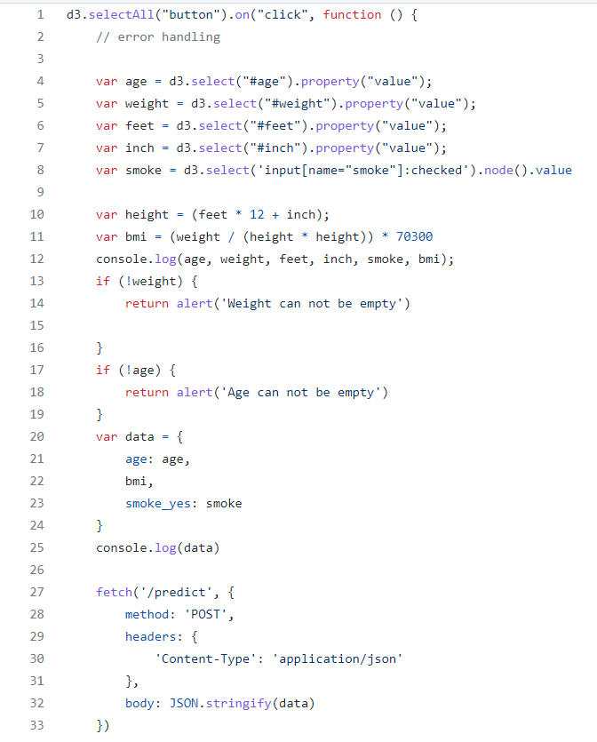
Deployment of the Website

Slide 13
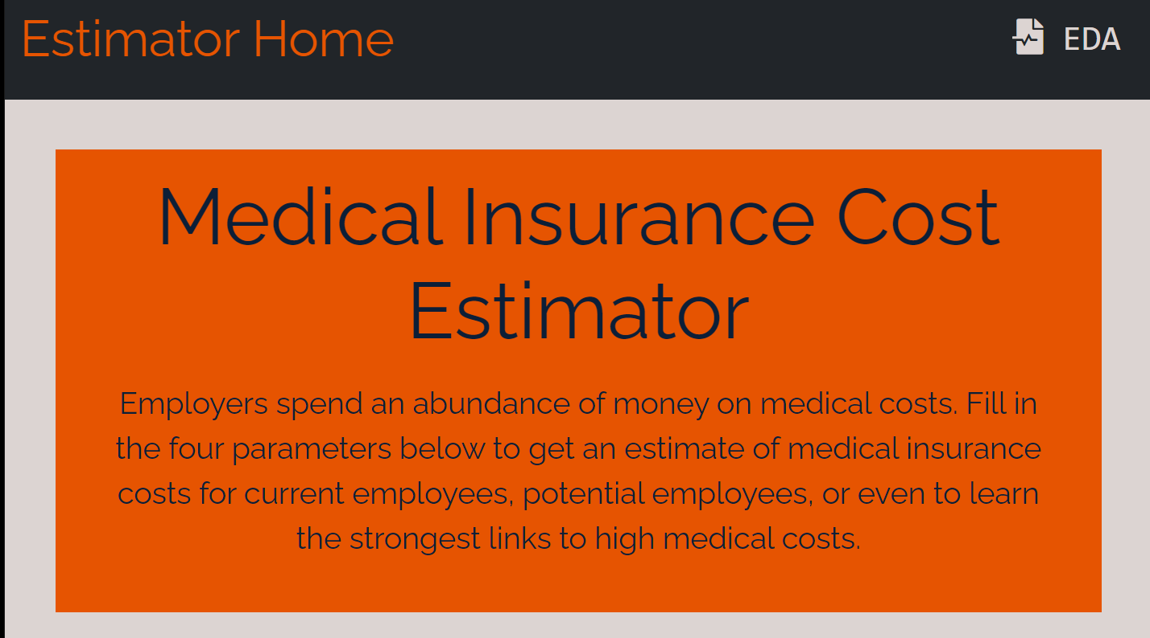

Website
https://medical-insurance-costs.herokuapp.com/

Slide 14

Next Steps / Insights
Additional pages expanding the exploratory data analysis
Ability to link site with widely-used human resources tools
Allow companies to upload their data to the site to improve accuracy

Slide 15

Q & A Thank you

